Slide 1
Ticket Booking Assignment
19126354 周裕清 YuqingZhou
19126332 邢桐 TongXing
19126306 罗钰琛 YuchenLuo
19126309 马洁 JieMa

Slide 2
Everyone's contribution
Yuqing Zhou: API document + data design
Tong Xing: Interface + API Gateway
Yuchen Luo: Message broker: RabbitMQ
Jie Ma: Testing

Slide 3
Yuqing Zhou

Slide 4
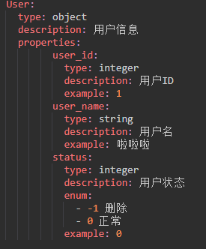
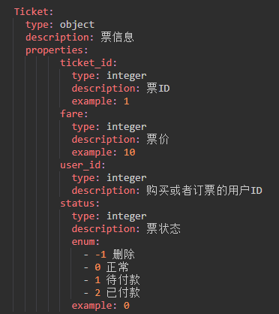
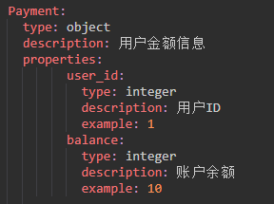
Data Schema

Slide 5
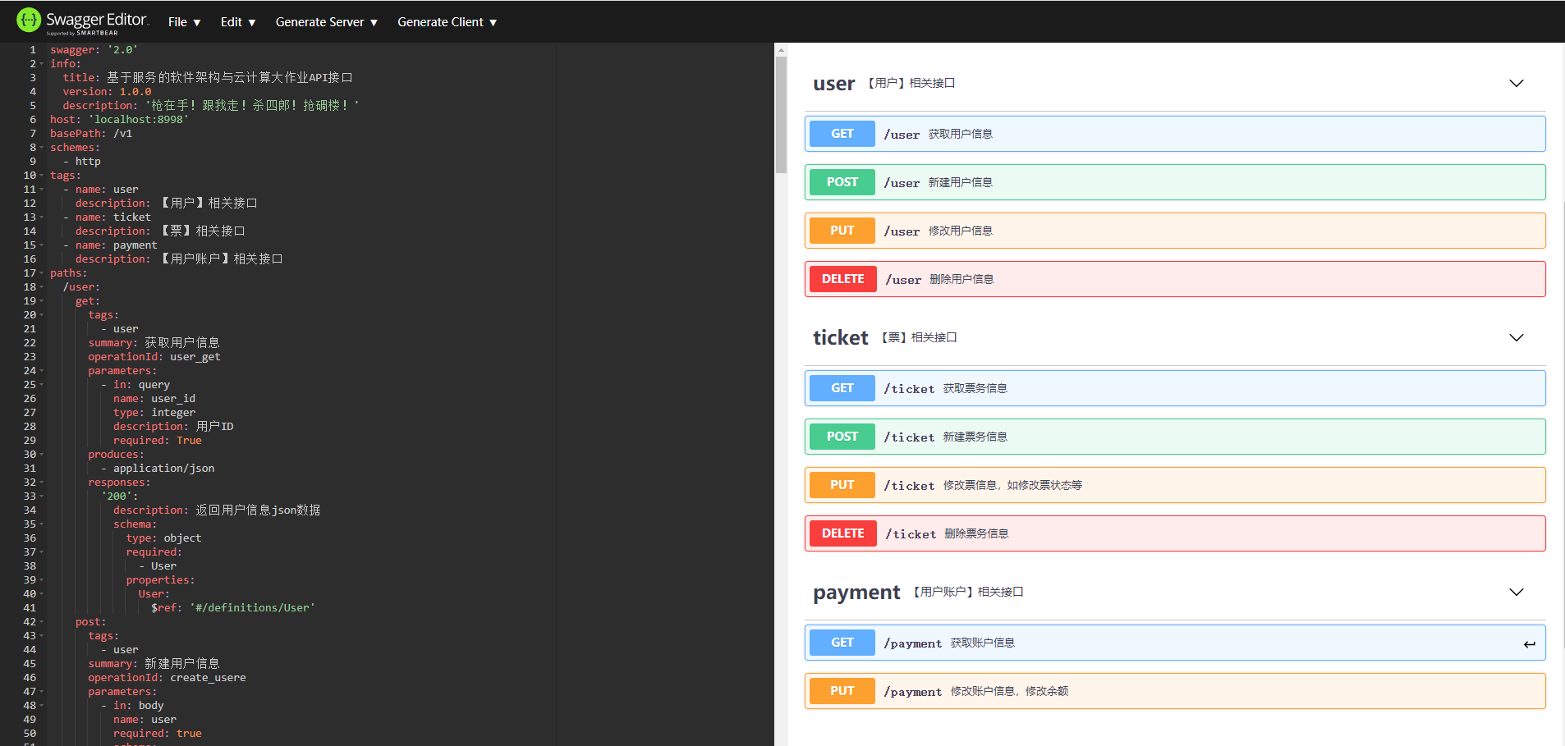
API Document

Slide 6
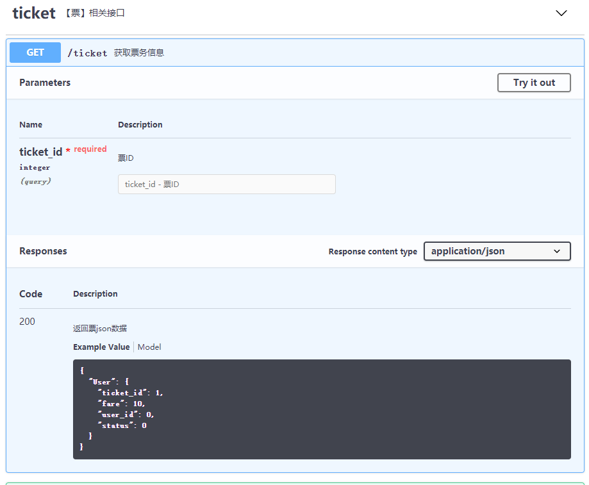
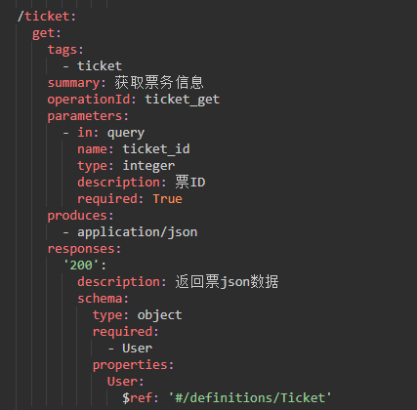
API Example

Slide 7
Tong Xing

Slide 8
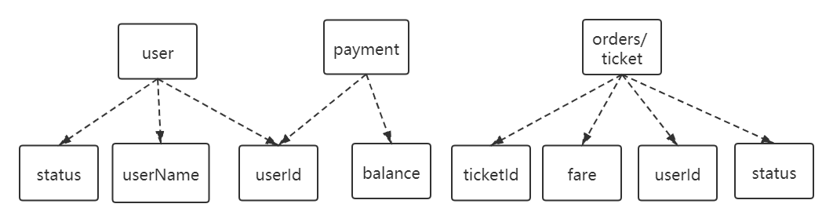
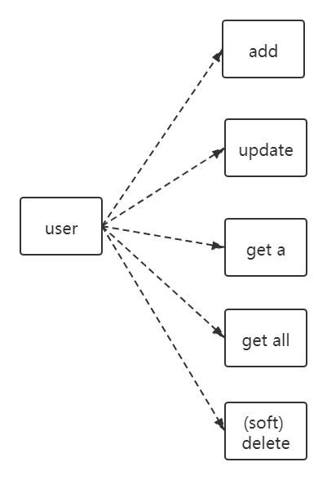
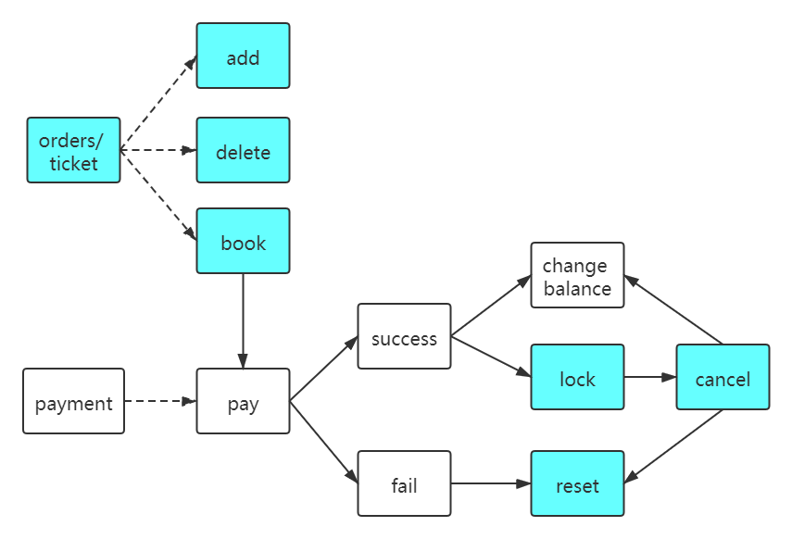
Interface

Slide 9
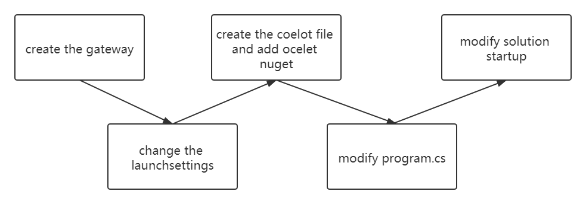
API Gateway

Slide 10
Yuchen Luo

Slide 11
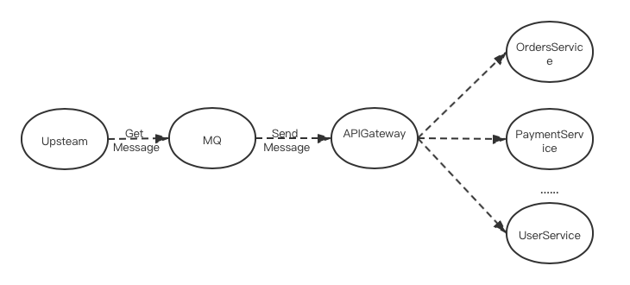
Middleware - RabbitMQ
MQ is a cross-process communication mechanism used to deliver messages upstream and downstream.

Slide 12
Middleware - RabbitMQ
Reasons to use RabbitMQ：
a) Asynchronous: Reduce the waiting time.
b) Peak-cutting and valley-filling: Reduce the sudden flow shocks.
c) Decoupling: After each module is finished, it is enough to send the message out, and the downstream module is to listen.

Slide 13
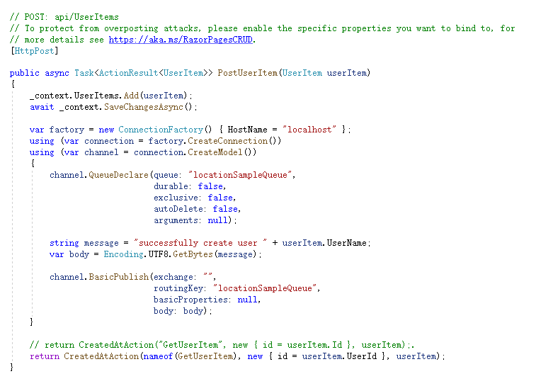
Middleware - RabbitMQ
Code：

Slide 14
Jie Ma

Slide 15
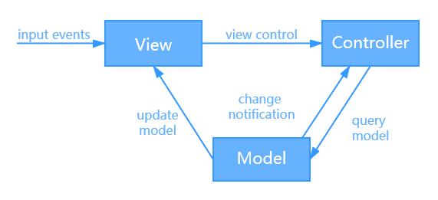
Architecture
Gateway Routing pattern：
The project uses MVC architecture.It consists of three parts：
Model: Responsible for storing the central data of the system.
View: Display information to the user.
Controller: Processing information input by the users.

Slide 16
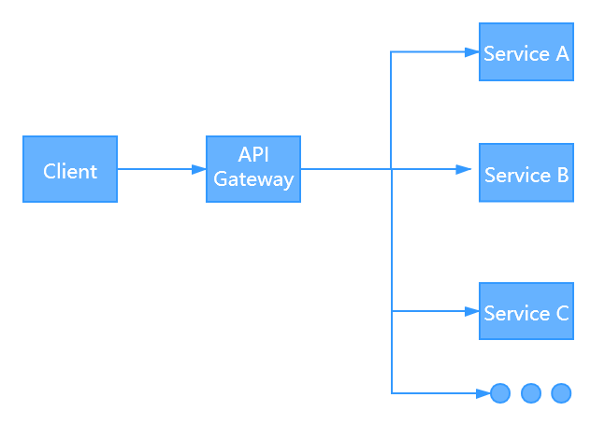
Design Pattern
Gateway Routing pattern：
This pattern route requests to multiple services using a single endpoint.

Slide 17
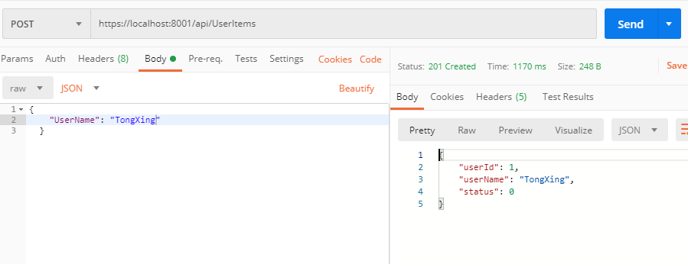
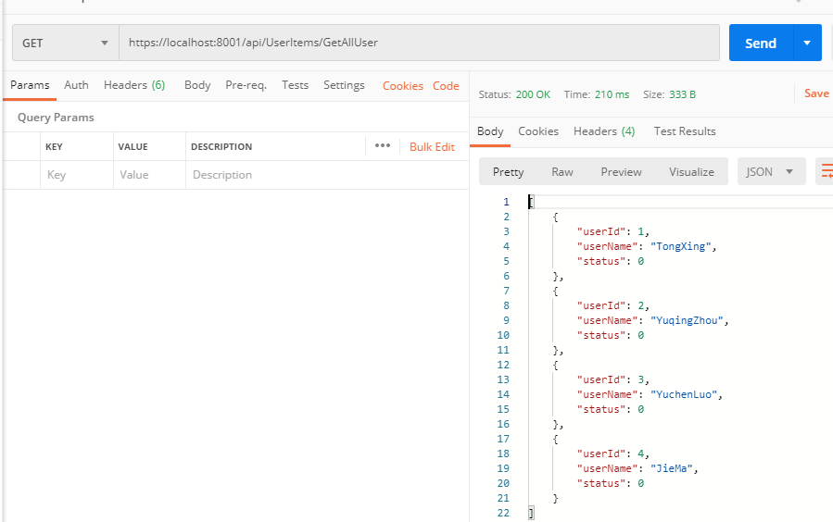
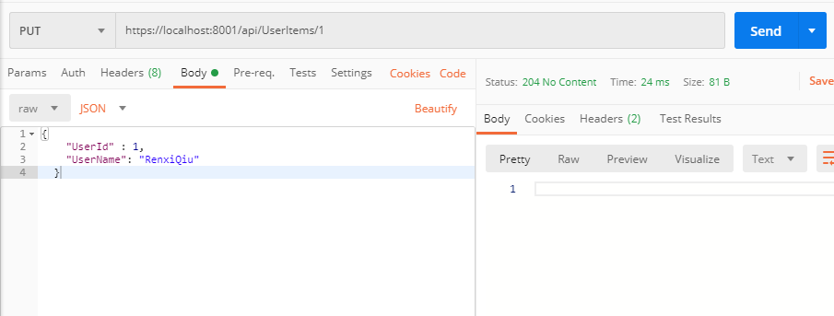
Testing Results
User microservice：

Slide 18
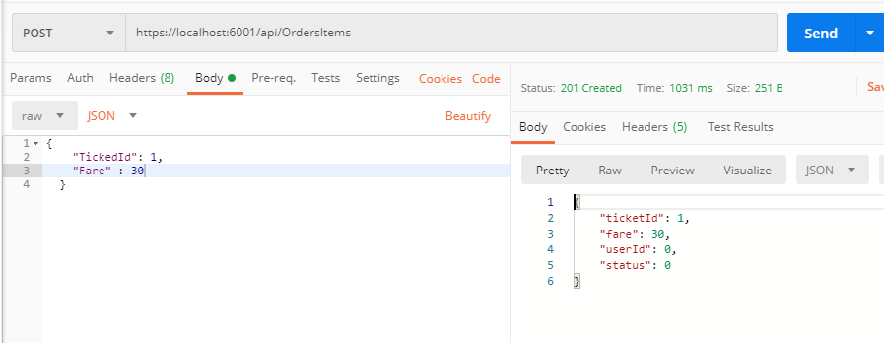
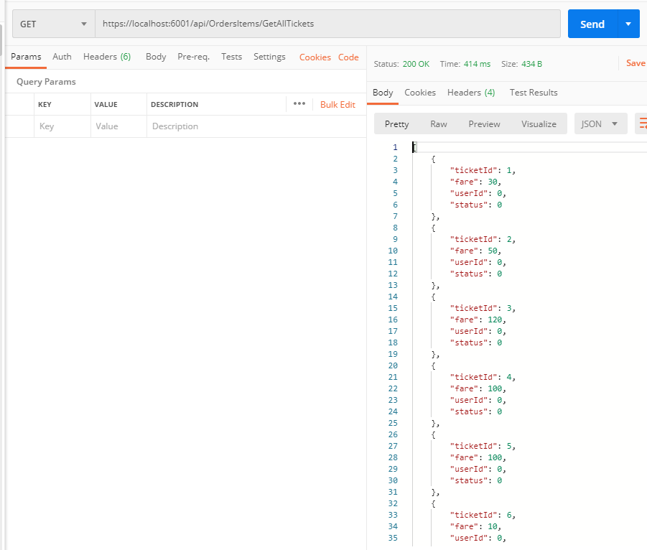
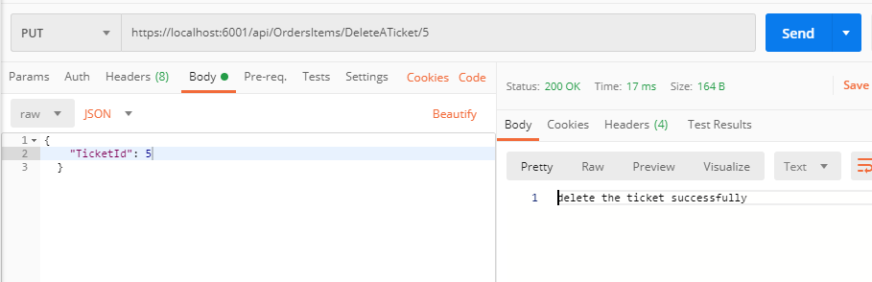
Testing Results
Ticket order microservice:

Slide 19
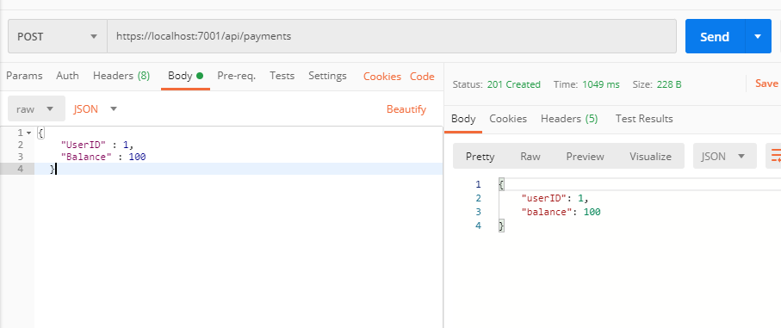
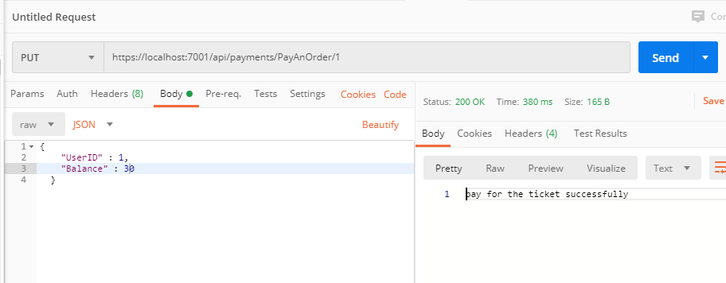
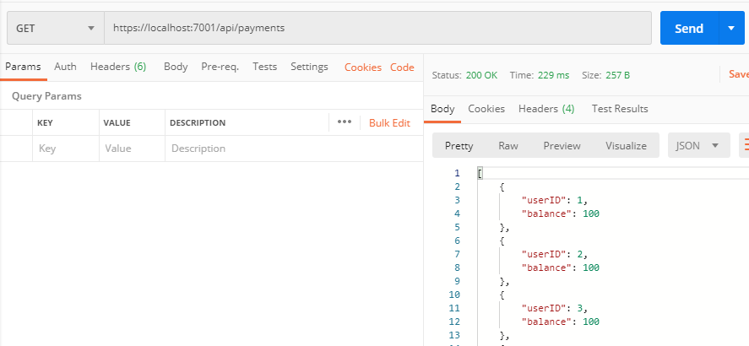
Testing Results
Payment microservice:

Slide 20
Thank you!

